Slide 1
FHIR Pratitioner 表單

Slide 2
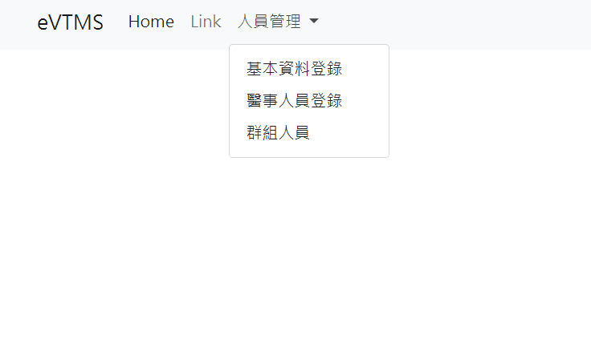
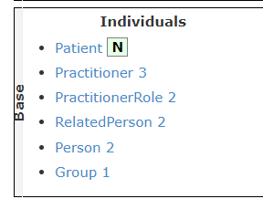
對應FHIR Resource

Slide 3
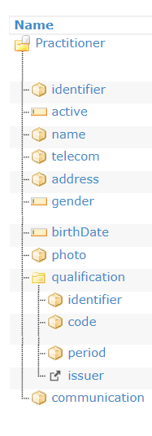
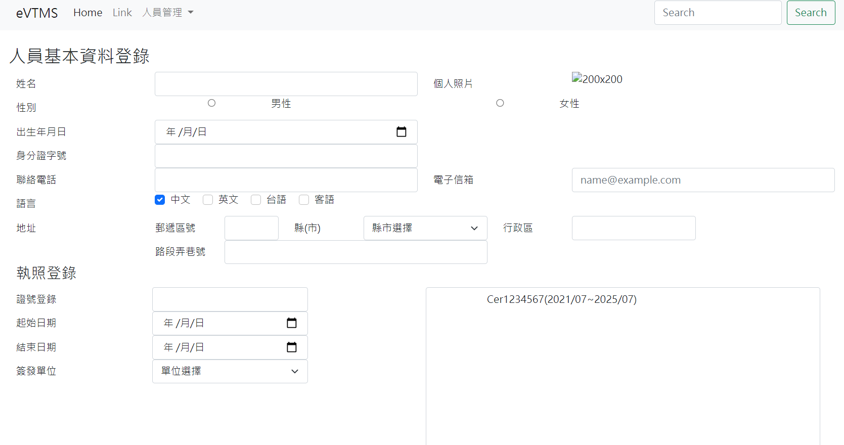
Pratitioner 表單對應標籤
name
photo
gender
birthDate
identifier
telecom
communication
address
qualification

